Slide 1

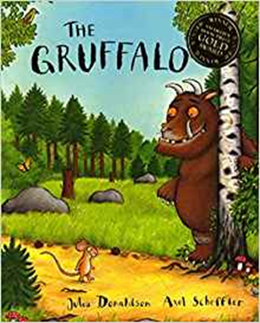

Reading in the Early Years
Nursery

Slide 2
Aims
To discover how to teach reading
To provide ideas to support reading development at home

Slide 3
Why is reading so important?
Literacy is one of the most important foundations for success in school and life.
Research has shown that literacy levels affect opportunities in life for education, employment, income and wellbeing.

Slide 4
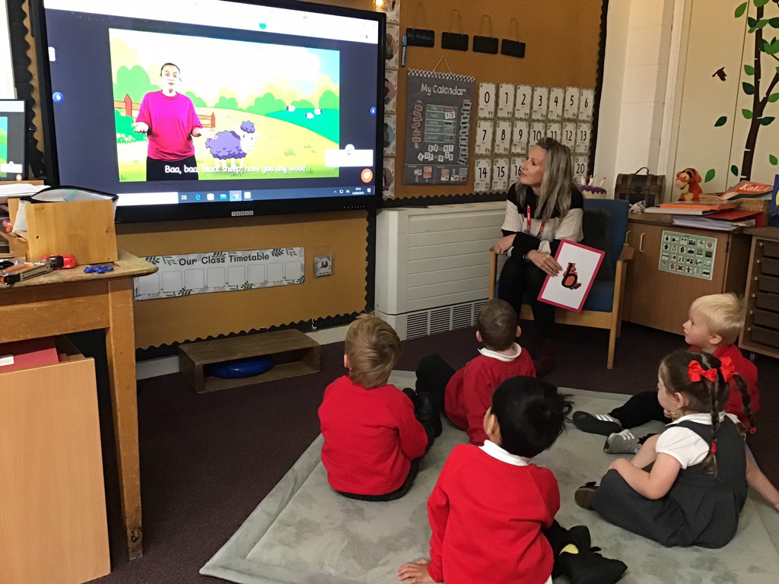
Why start so early?
Speaking and listening
Develop a love of reading
Building story language and vocabulary
Seeing how to read books
Reading for a purpose
Confidence

Slide 5
Before children start to read
They need to have a good grasp of language.
They should be able to talk in sentences either in English or their home language.
The more experience children have of language, the more easily they will learn to read.
Your child needs to hear and join in conversations (with adults and children) and listen to stories and poetry.

Slide 6
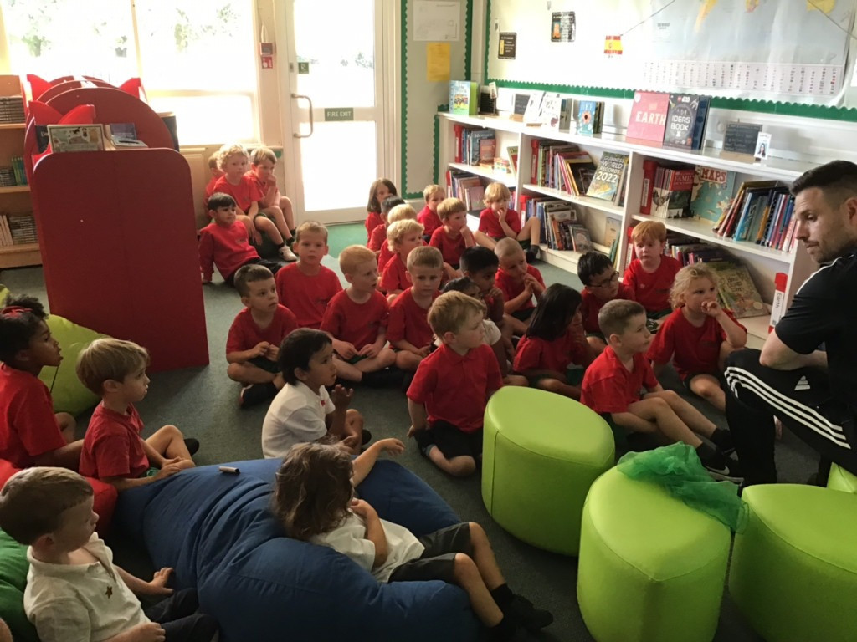
What is your child’s favourite book?
Share with the person next to you.

Slide 7
Concepts of print
Your child needs to know how to handle books:
Holding books the right way up
Turning the pages in sequence from right to left
Exploring and talking about the pictures
Knowing that the words can be read to tell a story
Be able to differentiate between a word and pictures.

Slide 8

Direction
Print goes from left to right, so children must be familiar with where to start each line and which direction to go in.
When you read to your child run your finger under the print.

Slide 9
Matching Finger
When we read, part of what we do involves matching.
Children learn to match shapes, patterns, letters and, finally, words.
This helps children to be able to match the print with their finger one spoken word at a time.

Slide 10
How can you support your child at home?
Build up an interest in stories and books.
Take your child to the library let them explore books and choose them.
Model choosing and handling books carefully, talk about the book you have chosen ask them about their choice.

Slide 11
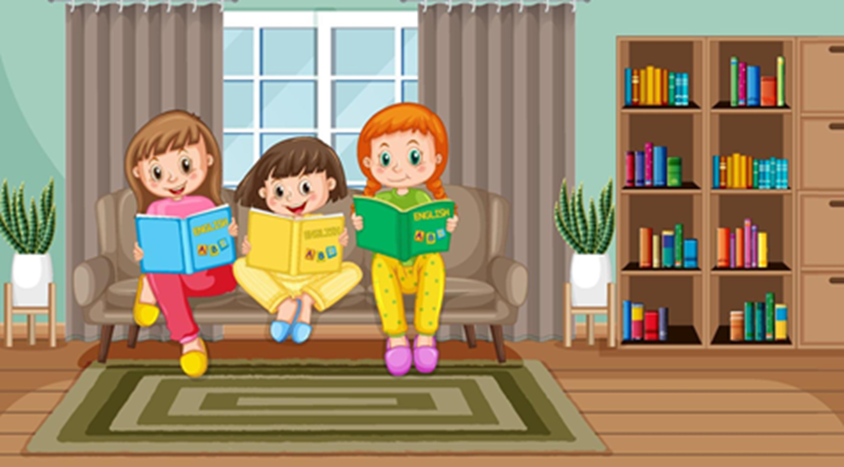
How can you support your child at home?
Read the same story more than once. Research suggests that repeated readings help children to develop language skills.

Slide 12
By the end of Nursery
Your child should be able to:
Hold a book the right way round
Identify the front and back cover of a book be able to turn the pages right to left, one at a time
Know which direction to read in, (left to right).
Be able to retell or recall the main parts of their favourite stories.

