Slide 1

Welcome to our reading workshop
Mr Horan

Slide 2
Aims
To discover how to teach reading
To understand phonics
To provide ideas to support reading development at home

Slide 3
Never too young!
Speaking and listening
Love of reading
Building story language and vocabulary
Seeing how to read books
Reading for a purpose
Confidence

Slide 4
What can you do to support your child at home?
Talk to them
Model and expect good listening
Encourage the understanding and use of new vocabulary
Sing songs, rhymes and read poems, enjoying rhyme and rhythm of words.
Read to your child regularly and develop their story language
Let them see you reading
Praise and encourage

Slide 5
What is your favourite childrens book?
*Share with the person next to you

Slide 6
What are the children expected to achieve by the time they finish Reception?

Slide 7
Development Matters-ELG
Comprehension:
Demonstrate understanding of what has been read to them by retelling stories and narratives using their own words and recently introduced vocabulary.
Anticipate (where appropriate) key events in stories.
Use and understand recently introduced vocabulary during discussions about stories, non-fiction, rhymes and poems and during role play.

Slide 8
Development Matters-ELG
Word reading:
Say a sound for each letter in the alphabet and at least 10 digraphs.
Read words consistent with their phonic knowledge by sound-blending.
Read aloud simple sentences and books that are
Consistent with their phonic knowledge, including some common exception words.

Slide 9
So how are we going to do this?

Slide 10
How do we teach reading at school?
Sharing stories, rhymes and songs
Modelling reading for a purpose
Words in the environment
Home reading diary- sound/ library/ reading books
Daily shared reading and writing opportunities
2x Weekly small group reading sessions
Sound booklets- how to use
Half termly one to one reading assessment
Daily phonic sessions

Slide 11
What strategies do we use to support reading?

Slide 12
Strategies taught to children
Can I blend the phonemes to read the word?-Explain- George’s Gym
Does the picture help me?
Does the word look like another word?
Can I see a word that I already know in the word?
Can I read on?
I need to ask for help!

Slide 13

Phonics in Reception

Slide 14
What is phonics?
A method of teaching people to read by correlating sounds with symbols.
https://www.littlewandlelettersandsounds.org.uk/resources/for-parents/

Slide 15
Phonics
Structured programme teaching letter sounds and tricky words
Fast pace, lots of consolidation
Blending for reading
Segmenting for writing
1 session per day

Slide 16
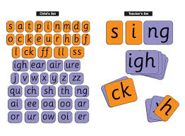
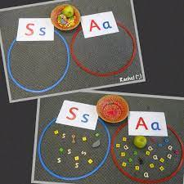
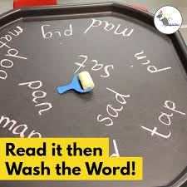
How we teach phonics
Daily short sessions
Specific order of teaching
Revisit previously
taught sounds at
start of each lesson
Repeated practice
Practice makes
permanent

Slide 17
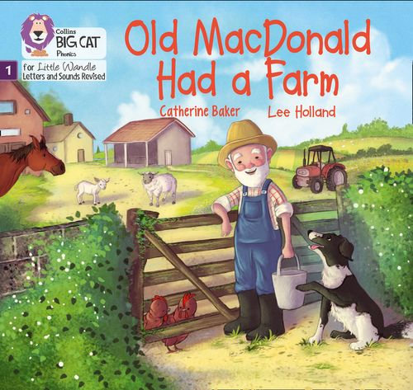
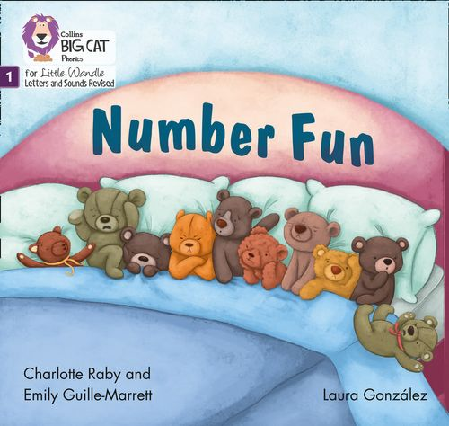
Once children have a secure knowledge of many
GPC’s (Grapheme Phoneme Correspondences)
and are confidently blending, they will be ready for
reading books
Before this they may have wordless books, which develop great language skills and teach children the layout of books and how to handle books.
https://www.littlewandle.org.uk/resources/for-parents/#tabnametabBooksComingHome

Slide 18
Reading Practice Books are carefully matched so children can read fluently and independently.
-Children are assessed, then LW matches which books
Should be allocated for their secure phonic knowledge
When children take their book home to read, they should be 95% fluent.
Please do not worry that a book is too easy – your child needs to develop fluency and confidence in reading.
Re-reading a book they have had before helps develop fluency – this is the goal.

Slide 19
Please engage in the activities provided and feel free to ask any questions that you may have

