Slide 1


Slide 2

Welcome to our EYFS Family
We are excited to start this journey with you and your child.

Slide 3
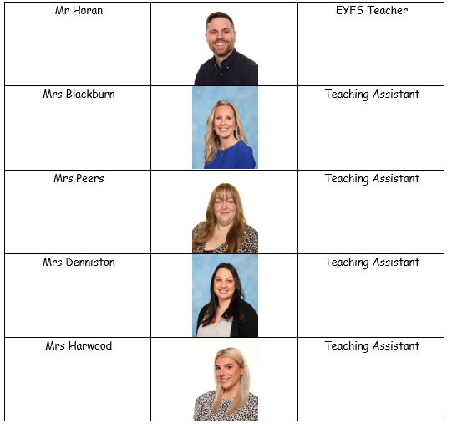
Introductions

Slide 4
Induction Meeting Aims:
To help your child make the best possible start to school.
To understand the curriculum that your child will be covering.
To identify how you can help your child at home and in school.

Slide 5
What is the Early Years Foundation Stage?
The Early Years Foundation Stage (EYFS) is the stage of education for children from birth to the end of the Reception year.
It is based on the recognition that children learn best through play and active learning.

Slide 6
Learning and Development
7 areas of learning.
3 Prime Areas –
Communication and Language
Personal Social and Emotional Development
Physical Development
4 Specific Areas of Learning –
Literacy
Mathematics
Understanding the World
Expressive Arts and Design

Slide 7
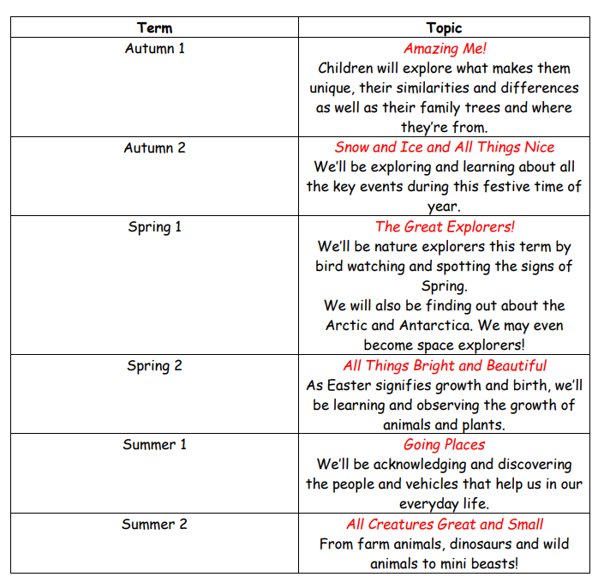
Our Curriculum

Slide 8
The first few weeks
We will find out what the children already know and can do and use this information to help us develop an individual learning program for each child.

Slide 9
Nursery
Tuesday 6th January- One hour with parents 10:30-11:30
Wednesday 7th January- One hour without parents- 10:30-11:30
Thursday 8th January- Children to start full-time

Slide 10
Arrival
Children are to be accompanied to their class door at 8:40 am
Hang up coats and bags
Start their learning
Collection
Morning session finishes at 11:40 am
All-day session finishes at 3:10 pm
Children are to be collected outside of the Nursery door
Breakfast and after-school club sessions

Slide 11

Tapestry
Login details in your pack.
Download the app.
See all your children’s lovely learning throughout the year.
A way of communicating with us.

Slide 12

Phonics
We follow the Little Wandle Phonic scheme.
In Nursery, the children learn Phase One and Phase Two phonics.

Slide 13
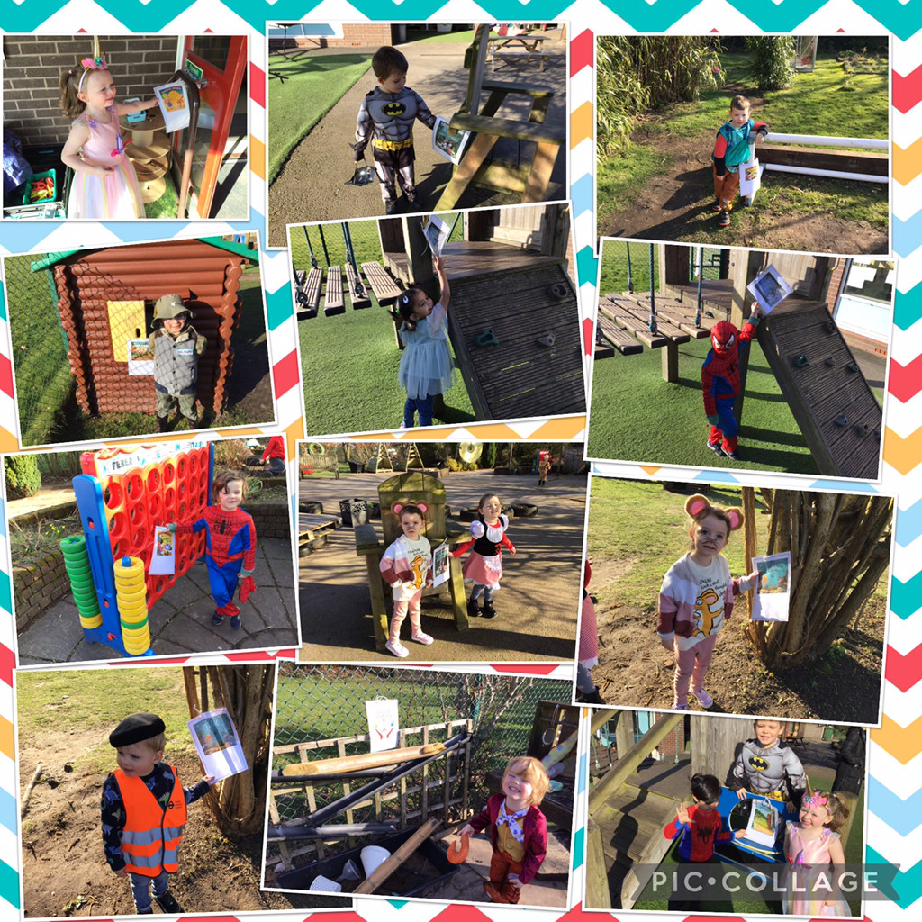
Reading
Nursery- Your child will be provided with a reading for pleasure book (library book.) This will be changed weekly.

Slide 14
How can you help your child?
Support their independence – eating/dressing/toileting etc
Read with them regularly
Encourage them to write/mark make
Point out numbers and give them reasons to count
Check their book bags regularly for letters, homework etc
Speak to us if you have any concerns or would like more information

Slide 15
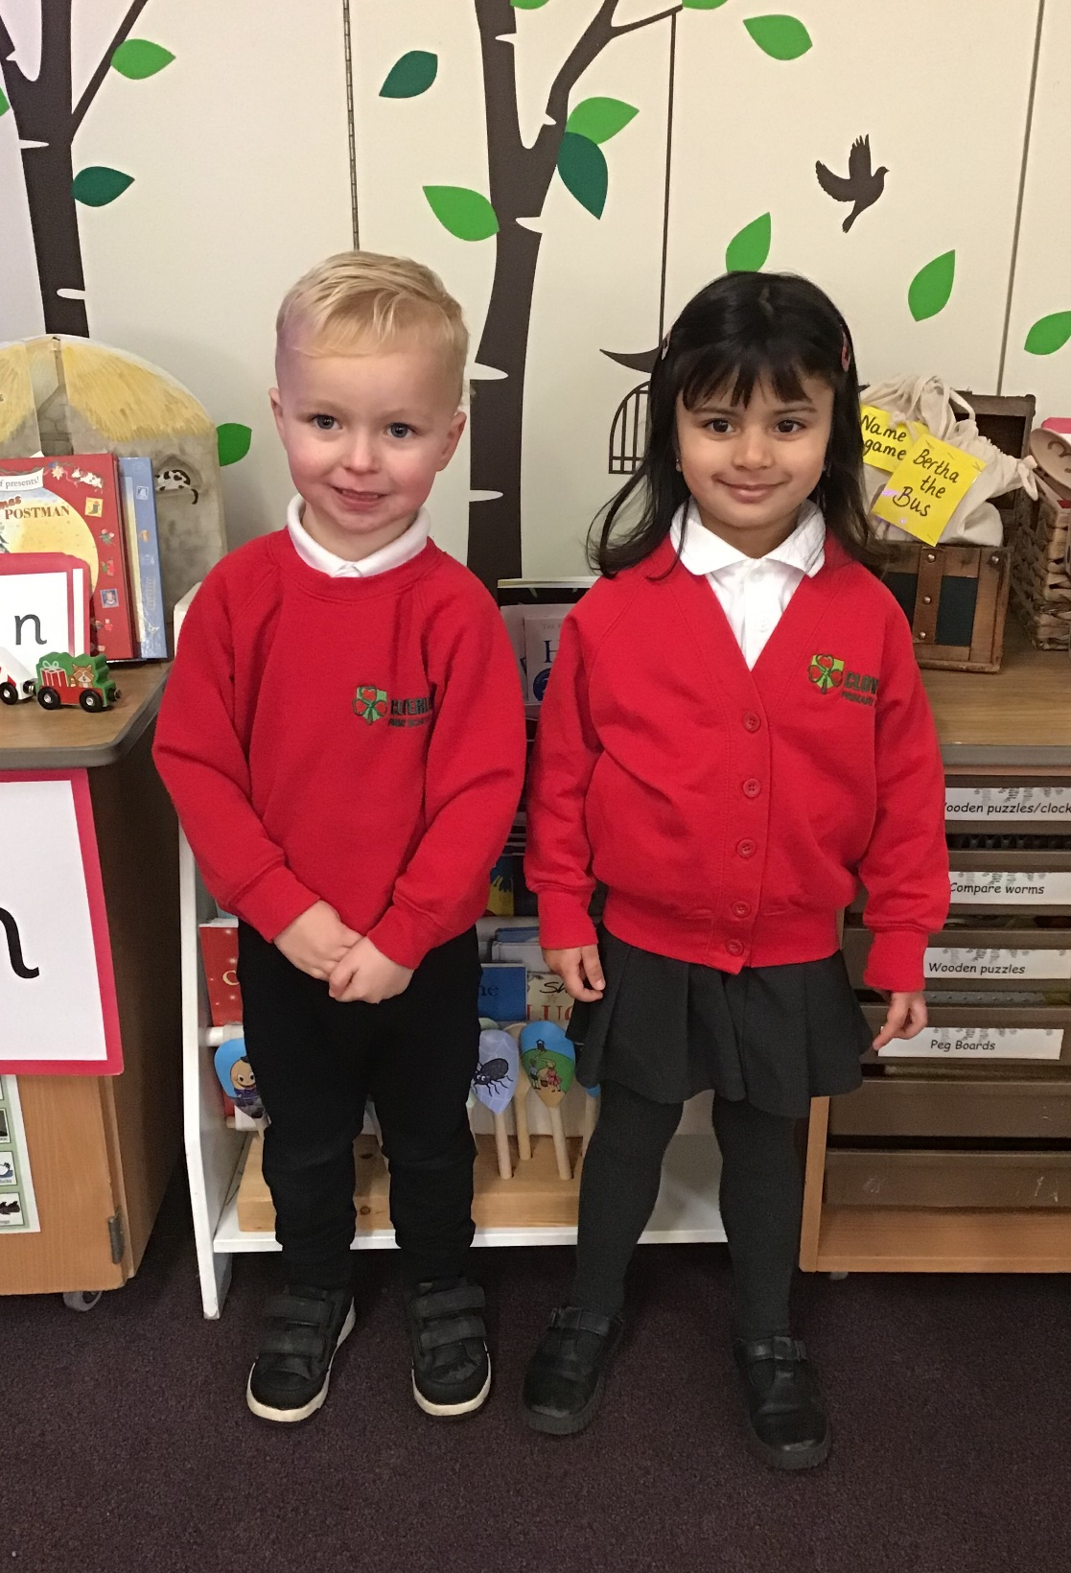
Nursery Uniform
Notes:
Winter boys- Grey trousers, white/ red polo shirt, red sweatshirt- logoed ones order from school
Summer boys- grey shorts, white/ red polo shirt, read sweatshirt-

Slide 16

Snack Time
Please complete the form in your packs if you would like your child to have milk.
Please ensure that your child brings their school water bottle into school each day with fresh water. These bottles are available to buy today for £2.00 and replacement lids are 60p. If for any reason the bottle leaks, please let us know and we will replace the lid.

Slide 17
Lunch Time
Nursery children will go to the hall at lunch.
After eating, the Nursery children will be brought back to the EYFS outdoor area.
Order online.

Slide 18
To enhance the learning experience, we kindly request a voluntary contribution of £1.00 per week, payable at the beginning of each half-term. Alternatively, you may choose to pay the full balance of £39 in September when your child starts. You will be informed of the amount due.
The money collected will help purchase items such as ingredients for playdough, cooking supplies, topic enhancements, and necessary equipment.
Nursery and Reception Fund

Slide 19
Polite Reminders
Attendance – Everyday counts
Absence – Please let us know (call /note)
Reading Folder – every day
Clothing – Please write name on everything
Shoes – Velcro is fantastic!
Outdoor clothing – Raincoat/Sunhat
Speak to us!

Slide 20
Thank you for coming.
We are looking forward to working with you and your child.

