Slide 1

Early Years Maths Workshop for Parents

Slide 2

The Curriculum in our school
White Rose scheme of learning:
“Adopting a White Rose Maths approach to teaching means making sure all children have the same opportunities to learn and the support they need to fully grasp concepts.” - White Rose

Slide 3
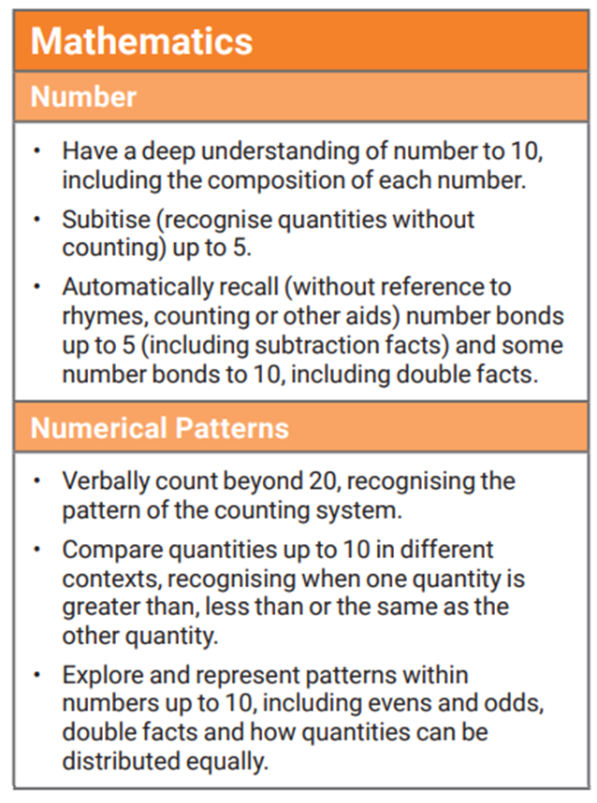
By the end of Reception

Slide 4
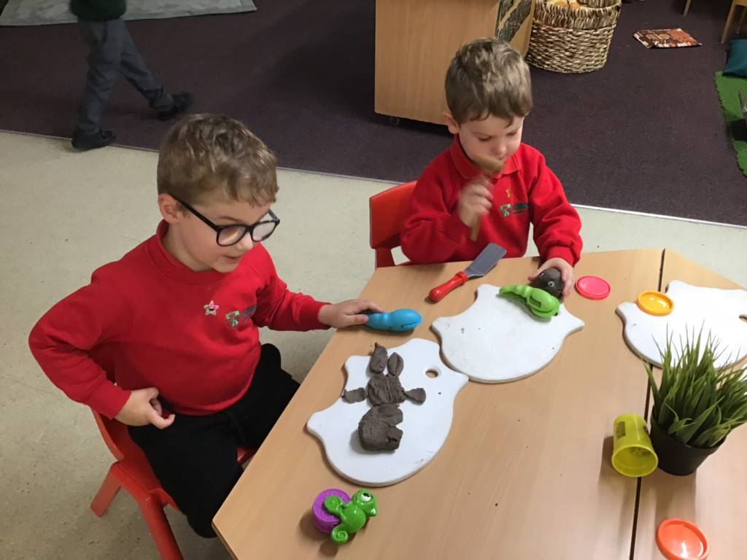
Learning through play at school and home
Play is essential in teaching and consolidating in maths.
Many of the maths objectives within Development Matters can only be developed during free play.
Play enables children to be independent and remain curious.

Slide 5
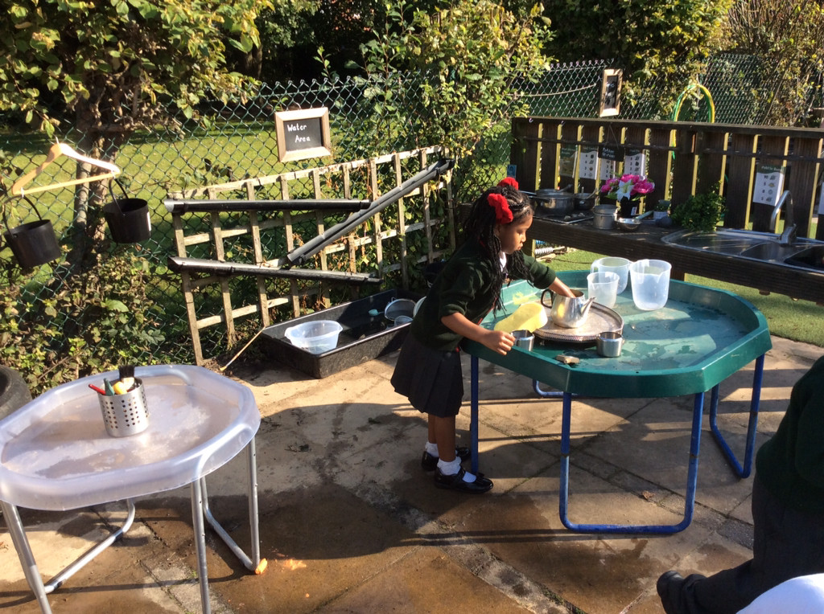
Learning through play at school and home
By setting up and supporting activities in the environment, like the ones you see here today, children are not only learning about one specific maths objective, but they are also learning so much more in other areas of learning; the possibilities are endless!

Slide 6
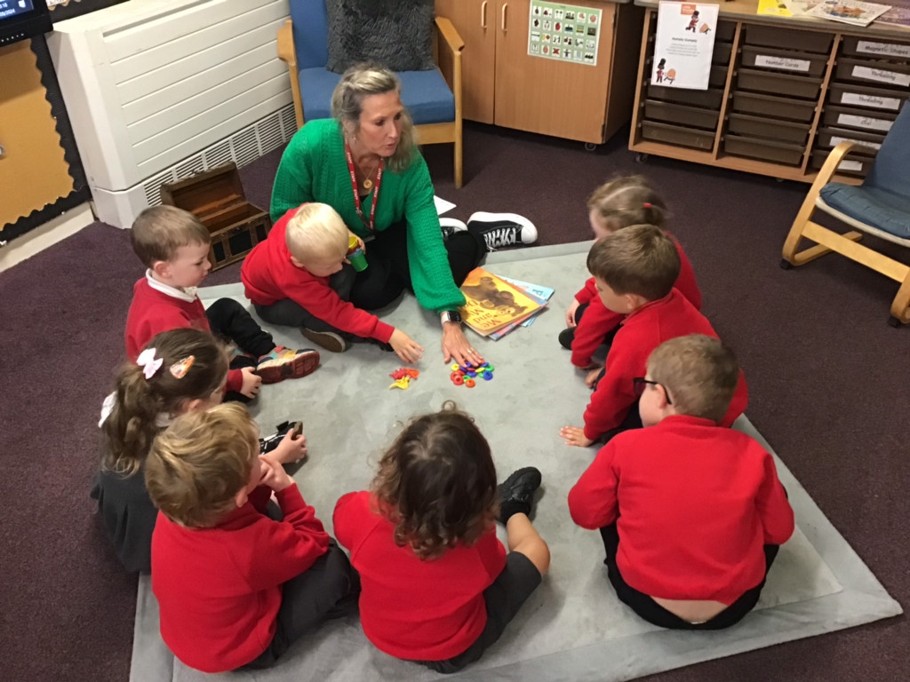
What can the environment teach in maths and how do teachers facilitate learning?

Slide 7
Mathematical Language
Lots of mathematical language for example more, less, big, small, wide, thin and positional language needs to be modelled by adults for children to learn and it is so much more effective if it's during authentic play experiences.
This can be replicated at home when doing everyday activities.

Slide 8
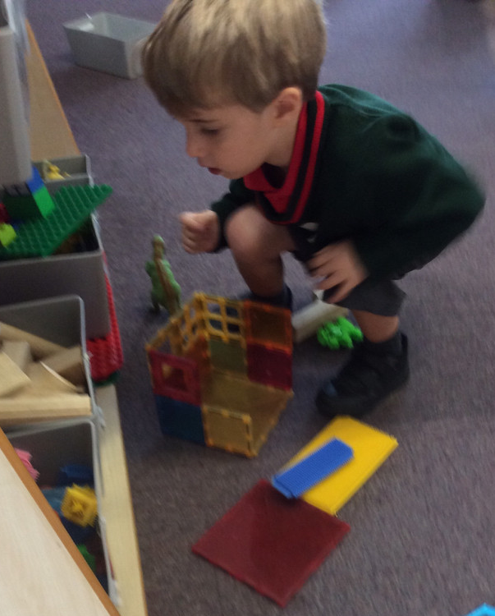
Problem solving, reasoning and pattern
Loose parts are also perfect for developing and embedding pattern creating.
Construction is another area where children can learn these undervalued skills.

Slide 9
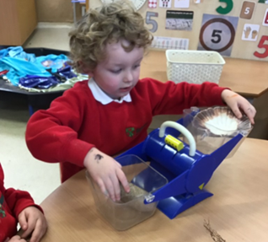
Weight and Measures
We model measuring for example outside during building and construction: large scales outside, small balance scales inside for children to explore.
Any cooking you do with your child at home will be helpful.

Slide 10
Money
The best way to learn about money is to use it purposefully. We use a role-play shop where children must buy things using money.
Children often think that money is just ‘tapping.’ Any shopping that children can help with at home will help embed the learning and not lose the key skill of being able to use coins.

Slide 11
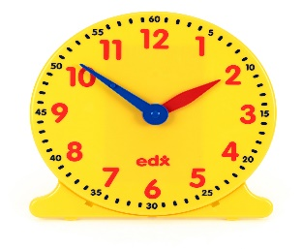
Time
We encourage children to use time every day for example measuring how long running races or car racing through guttering takes: estimate then check; will a sand timer work?
Modelling using stop clocks during races or games.
Ask children for the time.
When discussing the daily routine, we discuss times things happen.

Slide 12
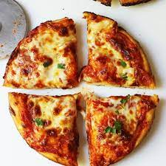
Fractions
At snack time we ask children to share things by cutting them in half and quarters.
You can encourage children to cut up sandwiches at home into halves and quarters or pizzas.

Slide 13
Other ideas to help at home
Sing number songs and nursery rhymes
Engage in imaginative play with your child
Play board games such as Orchard Toys
Go on a number or shape hunt at home

Slide 14
Maths Group Work
As well as learning through play, the children engage in a Maths carpet session daily.
Each week the children also engage in a small group maths activity. These can be practical, fun and sometimes messy!
Let’s have some fun!

